Slide 1
Database Systems
COMP3010E Fall 2025
Lecture 1

Slide 2

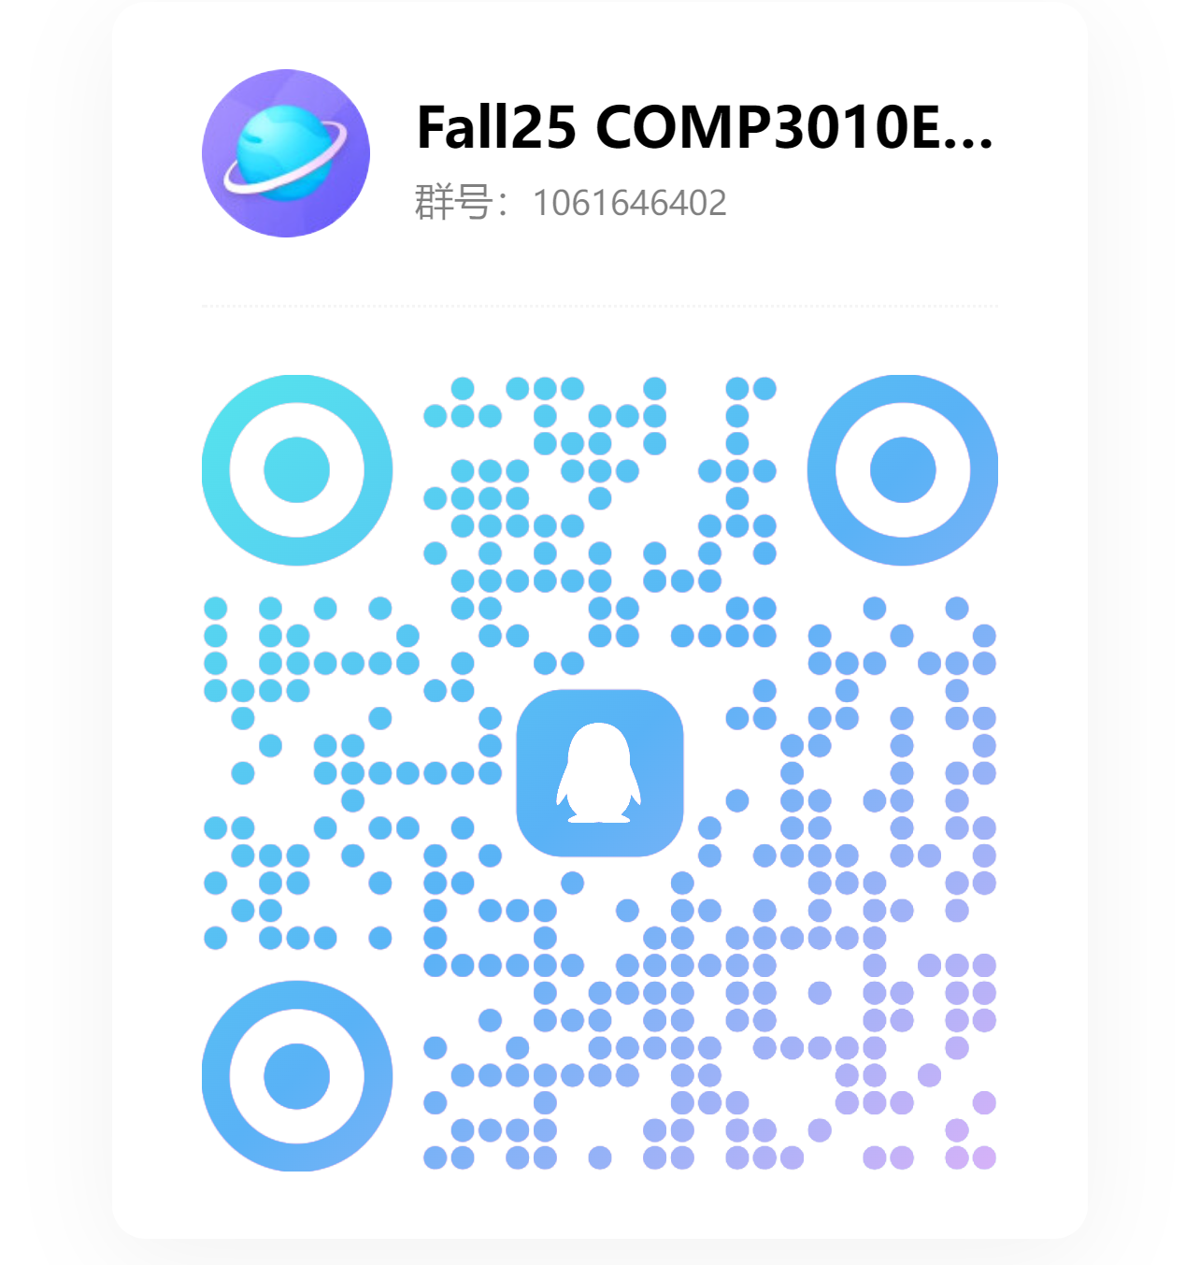
Instructor and Contact
Dr. Xun Zhou (Chinese name: 周逊)
Professor of Computer Science
Research Area: Big Data, Data Mining, Machine Learning
Previously at the University of Iowa in USA.
Assistant Professor (2014-2020),
Associate Professor with Tenure (2020-2023)
Email: zhouxun2023@hit.edu.cn
QQ group (please scan QR code here, required)
All announcements & homework will be posted here
Homework submission: Email.

Slide 3
Course Info
COMP 3010E Database Systems
Total Credits: 4, Total Hours: 64, Lectures: 40, Labs: 24 (6 labs)
Teaching Schedule:
Lectures: weeks 1-11 (weeks 5 and 6 have holidays), T & Th 2pm-3:45pm
Labs arranged in weeks 4, 6, 7, 8, 9, 10 (see specific notifications in QQ group)
For international undergraduate students in Computer Science major
Official language: English only

Slide 4
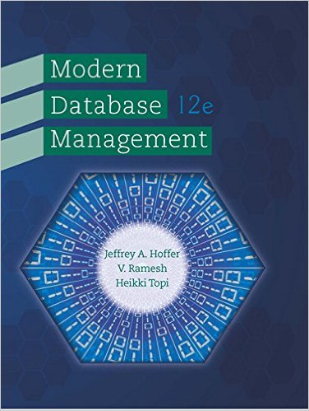
Course Overview (1)
Objective:
Learn the core concepts and technologies of database systems to effectively manage and
analyze data for decision making
Main topics:
1. Conceptual Data modeling (E-R model, enhanced E-R model)
2. Database design (relational model)
3. SQL (Structured Query Language)
4. Web-based database application
5. Data warehousing and data mining
Textbook:
Jeffrey A. Hoffer, V. Ramesh, Heikki Topi, "Modern Database Management", 12th Edition,
Prentice Hall, 2012. (e-book OK, for reference only)

Slide 5
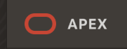

Course Overview (2)
Oracle Application Express (APEX)
Develop a Web-based database application (Lab 6)
Application Express Tutorials: https://docs.oracle.com/search/?q=Application%20Express%20Advanced%20Tutorials&product=en%2Fdatabase%2Foracle%2Foracle-database%2F23&pmode=ALL&lang=en
Reference book: Abraham Silberschatz, Henry F. Korth and S. Sudarshan, Database System Concepts, McGraw-Hill Education, 7th Edition. (Optional reference)
Course materials
Will be posted on our QQ Group

Slide 6
Assignments and Exams
3 HW assignments = 15% total points
6 Labs (24 hours) = 25% total points
1 Final Exam = 60% total points
See QQ group for HW and Lab report submission instructions.
Late submissions are absolutely NOT accepted.
Exam is closed book, closed notes.
See syllabus for more details

Slide 7
Class Participation (Must Read Carefully!!)
You must attend classes and stay till the end! Do not walk in and out during lecture.
We collect hand-written in-class exercise in lectures for attendance record.
Please bring a pen and a notebook/paper to every class.
Submitting exercises for others is Not Allowed.
Missing 1/3 of the lectures will result in DQ in final exam.
For medical or other valid reasons: you must seek approval from instructor IN ADVANCE and provide VERIFIABLE PROOFS.
Fulfill your own responsibility as a student!

Slide 8
Labs (tentative time, subject to change)
Location: T2510 (Not here!)
Lab 1 Database Design (ER Diagram, Relational Model) (Week 4 Wed, 2pm-5:45pm)
Lab 2 SQL 1 (software environment, basic operations) (Week 6 Thu, 8:30am-12:15am)
Lab 3 SQL 2 (simple queries) (Week 7 Wed, 2pm-5:45pm)
Lab 4 SQL 3 (join queries and subqueries) (Week 8 Wed, 2pm-5:45pm)
Lab 5 SQL 4 (SQL Hackathon) (Week 9 Wed, 2pm-5:45pm)
Lab 6 APEX Database Application Development (Week 10 Wed, 2pm-3:45pm & Fri, 10:30-12:15am )
Please check QQ group for reminder and details.

Slide 9
Labs
Attendance is required (same as lectures). Missing over 1/3 labs will lead to DQ in final exam as well.
Follow steps and demonstrations to complete tasks and answer questions.
Submit a lab report by the end of the lab session (or deadline if given extension).
Missing or late submission of lab report will lead to 0 points for that lab
Lab points: 3+3+4+4+5+6 = 25

Slide 10
SQL Hackathon (week 9)
One of the lab sections will be used for SQL test
Given two-lectures’ time, program in SQL to solve problems.
Open book and open notes. No web search.

Slide 11
Academic Integrity
Violations that are NOT allowed:
Submitting for others (in-class exercise, hw, lab, exam)
Copying others’ results OR copying solutions on the Internet
Using AI tools to generate solutions (we have algorithms to detect that)
Confirmed violations will be subject to DQ in final exam.
In-class exercise can be discussed. Other deliverables must be done individually.

Slide 12
Question?

Slide 13
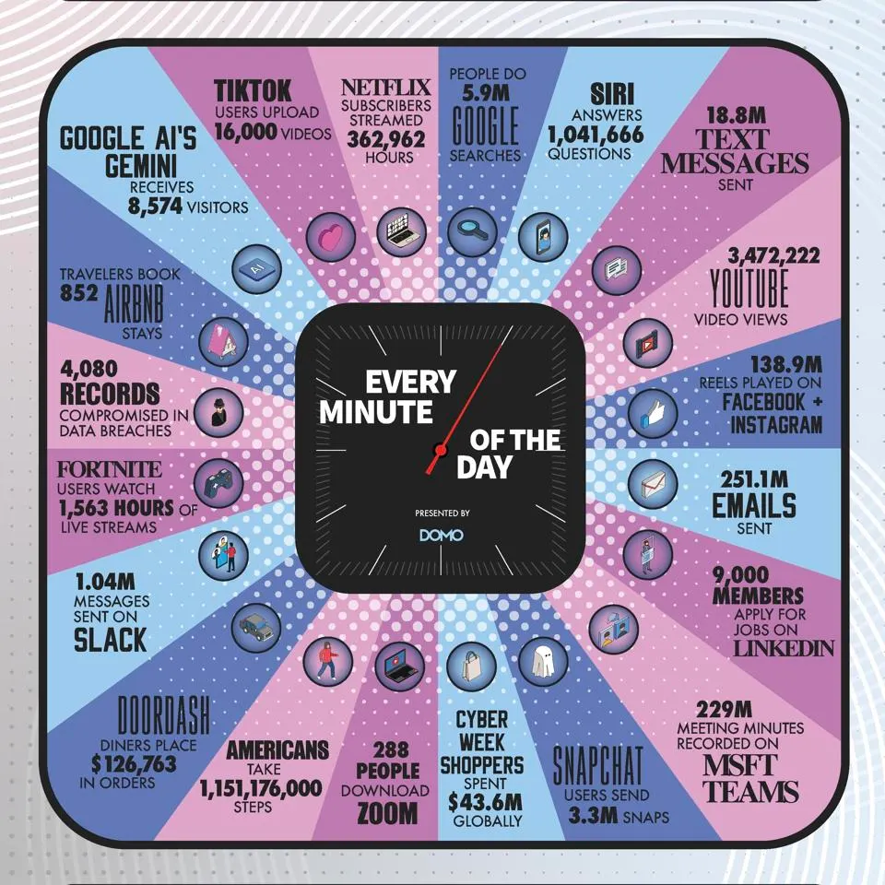
Big Data and Big Value
How much data is generated everyday?
Approximately 402 Exabyte of data is created each day (estimated)
Byte, KB, MB, GB, TB, PB, EB, ZB, YB
1 Exabyte = 10¹⁸ bytes
= 1 million hard drives (1TB size)

Slide 14


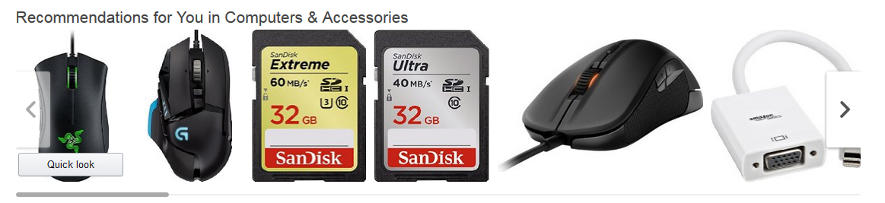

Big Data Analytics in Our Life
Ride-sharing and taxi services
Matching passengers with drivers through big data
Optimal matching to save time and maximize revenue
Streaming: precise ads delivery
Record user activities
Analyze user interests
Place advertisements and other promotions during a video
E-Commerce: Recommendation System
Data mining
Discover customers’ buying patterns/preference to maximize purchase opportunity

Slide 15

Importance of Databases
data
Value of Big Data
data → Information → Knowledge
More data → More difficult to store, manage, and query
Database Systems
Achieve program-data independency
Reduce data redundancy
Reduce data inconsistency
Improve data access
Improve data sharing
Improve data security
Improve decision making
Data Warehouses
Large-scale datasets
OLAP (online analytical processing), Data Mining
data
data
data
data
data
database
management
analysis
operation

Slide 16
Roles of Databases
Operational Systems
Run a business in real time
Current/operational data
e.g., order processing, sales reporting
Informational Systems
Support decision making
Historical and prediction data
e.g., sales-trend analysis
Two Distinct Roles:
In support of operational needs
OLTP – Online Transaction Processing
Record transactions
In support of data analysis
OLAP – Online Analytical Processing
purchase-pattern analysis
Sales Reporting
Business Intelligence
(complex analysis, data mining etc.)
Order Processing
Current/Operational Data
Historical/Prediction Data

Slide 17




Supporting Operations
Simple operations (INSERT, DELETE, SELECT, UPDATE)
Focus on supporting transactions for multiple users and applications
Examples:
Insert the details of a customer’s information into the database
Find the products contained in an order

Slide 18
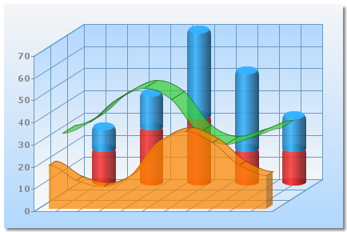
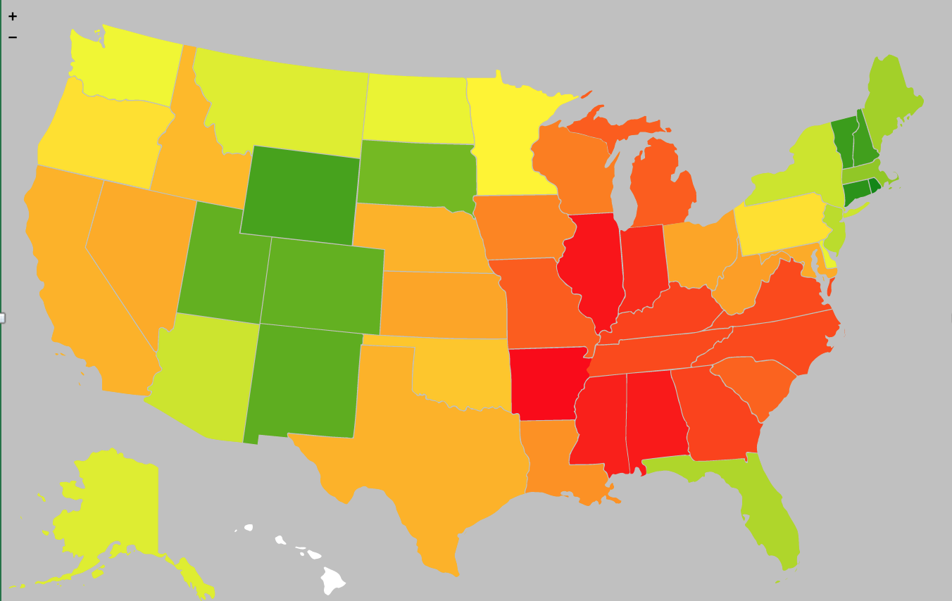

Supporting Analysis
Small number of complex queries
Focus on supporting sophisticated data analysis for decision making
Examples:
Can we predict the sales of this year based on the data from previous years?
Find the states that have an unusual correlation (positive or negative) with different types of products
Find the pairs of products that frequently appear together in the orders

Slide 19
What if….
You are given a database
How to use it to manage data
How to perform analysis on it?
You are asked to design a database
how to organize the data?
how to populate data into a database?
how to implement query algorithms?
Key skill for data-related jobs.

Slide 20
Road Map for this semester
Part I: Introduction to Databases
Part II: Data Modeling
Conceptual representation of the data
Entity-Relationship (E-R) model, Enhanced E-R model
Part III: Database Design
Logical representation in a relational database
Relational model and normalization analysis
Part IV: SQL (Structured Query Language)
How to query a relational database
Basic and advanced SQL queries
Part V: Advanced Topics
Relational Algebra
Database storage, query processing
Transaction management
Data warehousing and mining
Labs: APEX for Database Application
Implement a database application
Web pages, charts and reports.

Slide 21
Introduction to Databases
Concepts: Data, Information, Metadata
Traditional File Processing Systems
Database Systems
Development Process

Slide 22
Data
Definition
Stored representations of important objects and events in user’s environment
Examples: customer name, contact info, purchase records, etc
Types
Structured data
Examples: name, address, credit number, transaction date, etc
Stored in tabular form, such as tables, relations, spreadsheets
Can be easily mapped into pre-designated fields, e.g., (xxx) xxx-xxxx for phone number
Unstructured data
Examples: document, map, photo image, sound, video clip, etc
Do NOT fit neatly in the row-column fields of a database
Hard to retrieve the information contained in the data

Slide 23
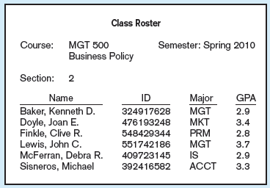
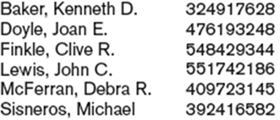
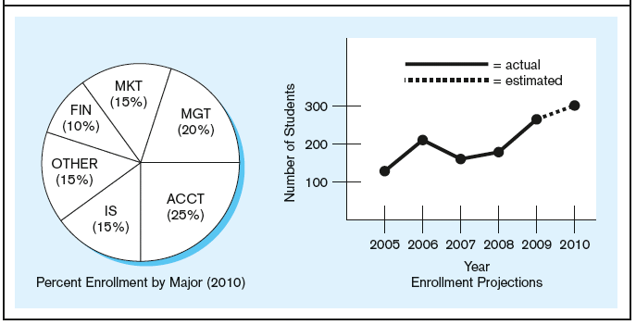
Information
Definition
Data that have been processed to increase knowledge
Conversion: Data → Information
Place the data in some context
Summarize/analyze the data

Slide 24
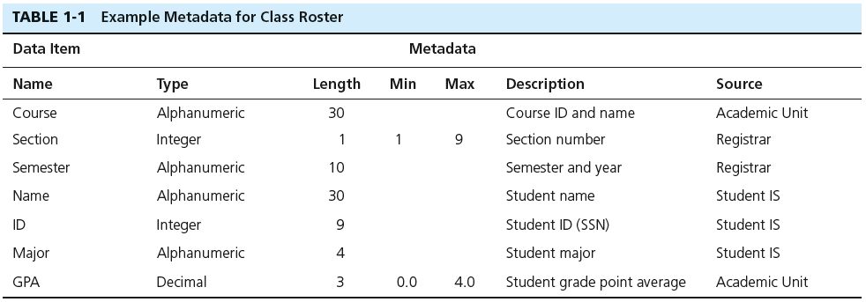
Metadata
A primary mechanism for providing context for data
Definition
Data that describe the properties or characteristics or context of end-user data
“Data about data”
Managing metadata is important
MetaData
Data

Slide 25

Quick Question: Data or Metadata
In the “driver information” database maintained by the DOT:
Driver’s name, address, and date of birth
A photo image of the driver
The fact that the driver’s name is a 30-character field
The resolution (in megapixels) of the camera that was used to photograph the driver
The fact that the date of birth must precede today’s date by at least 16 years
data
data
metadata
metadata
metadata

Slide 26
Introduction to Databases
Concepts: Data, Information, Metadata
Traditional File Processing Systems
Database Systems
Development Process

Slide 27
Why Database?
The model database model was first developed in 1970’s and became popular in late 1980s.
Before that, how did people manage data in businesses?
Programs + Data files → Legacy File Processing

Slide 28
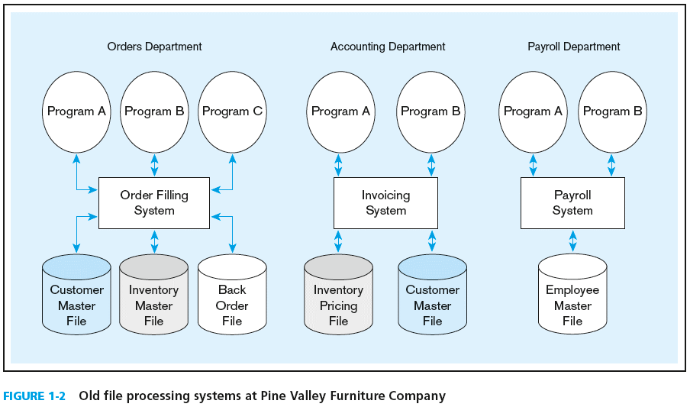
Legacy File Processing Model

Slide 29

Program-Data Dependence
Metadata information (data-file format, structure) must be included in the code of program
Any changes to data-file format (e.g., add a field) lead to changes to all related programs
Program A: Place an order for customer X on product Y
Need to read customer file
Need to read / update order file
Need to read /update inventory file
…
“Credit card” has been added as a new info of each customer | Update A….
Product description length 100 characters to 200 characters | Update A…
Inventory add “country” info as a result of international business expansion | Update A…
… | …

Slide 30


Duplication of Data
Applications developed independently – File duplication in the system
Waste of storage space
Hard to keep all copies up to date → Data inconsistency
Order Dept: “Discount! New Price $20”
Customer:
Accounting Dept: “Price: $50, you owe us $30!”
Customer:

Slide 31
Other Issues
Limited Data Sharing
Each program has its own private files
No centralized control of data
Lengthy Development Times
Design data file format and descriptions
Write the file access logic
Excessive Program Maintenance
Programs must change if file format changes

Slide 32
Introduction to Databases
Concepts: Data, Information, Metadata
Traditional File Processing Systems
Database Systems
Development Process

Slide 33
The Database Solution
Order Filing
System
Central database
Contains employee,
order, inventory,
pricing, and
customer data
Invoicing
System
DBMS
Payroll
System

Slide 34
Database Management Systems (DBMS)
Database is a collection of data items that are related and are managed as a single unit
DBMS is a software that manages (creates, maintains, and provides controlled access to) user databases
Database:
University Database: student, faculty, buildings, departments, courses, enrollment…
Company Database: employee, customer, order, product, orderline …
DBMS:
Oracle DB 21c
Microsoft SQL Server
A database can be managed by any DBMS (with necessary format).

Slide 35
Advantages of Database Approach
Program-Data Independence
Separation of data description (metadata) and physical storage from application programs
Reduce Data Redundancy
Data are stored in only one place and only once in the database
Improve Data Consistency
No duplication and easy to update
Improve Data Sharing
A shared corporate resource; user views
Increased Productivity of Application Development
Reduce Program Maintenance
Order Filing
Database
(Employee
customer,
Product]
Invoicing
DBMS
Payroll

Slide 36
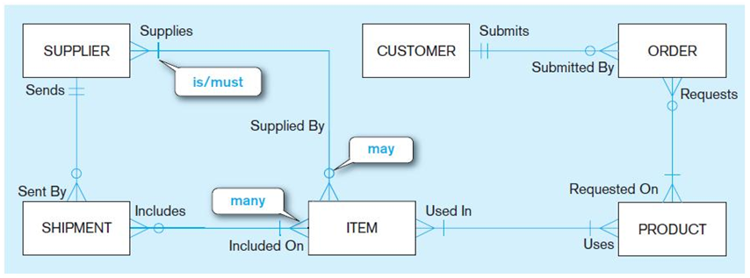
Data Modeling
Conceptual Model
Capture the nature of relationships among data
It is about understanding the business rules and the requirements
Logical Model
Transform the conceptual model into a logical representation of data
It is about creating the database structure (e.g., tables in relational data model)
Physical Design
Translate the logical model into technical specifications for storing/retrieving data
It is about storing data to achieve data processing efficiency and data quality
CUSTOMER
ID | Name | Address
101 | David Hills | …
102 | Mary Lee | …
Index and file organization on disk

Slide 37
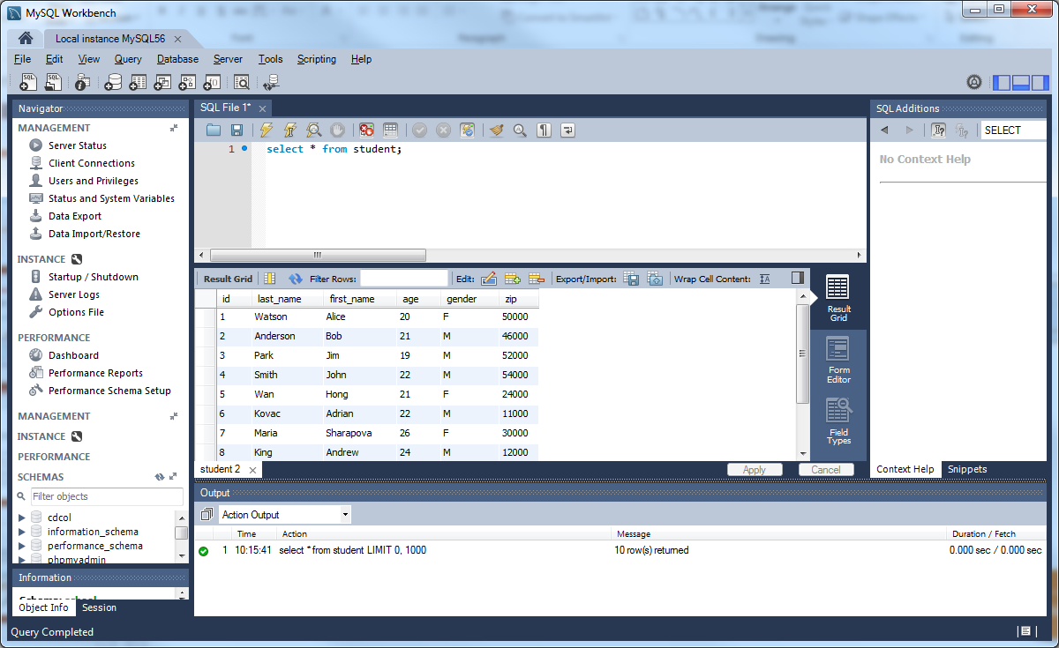
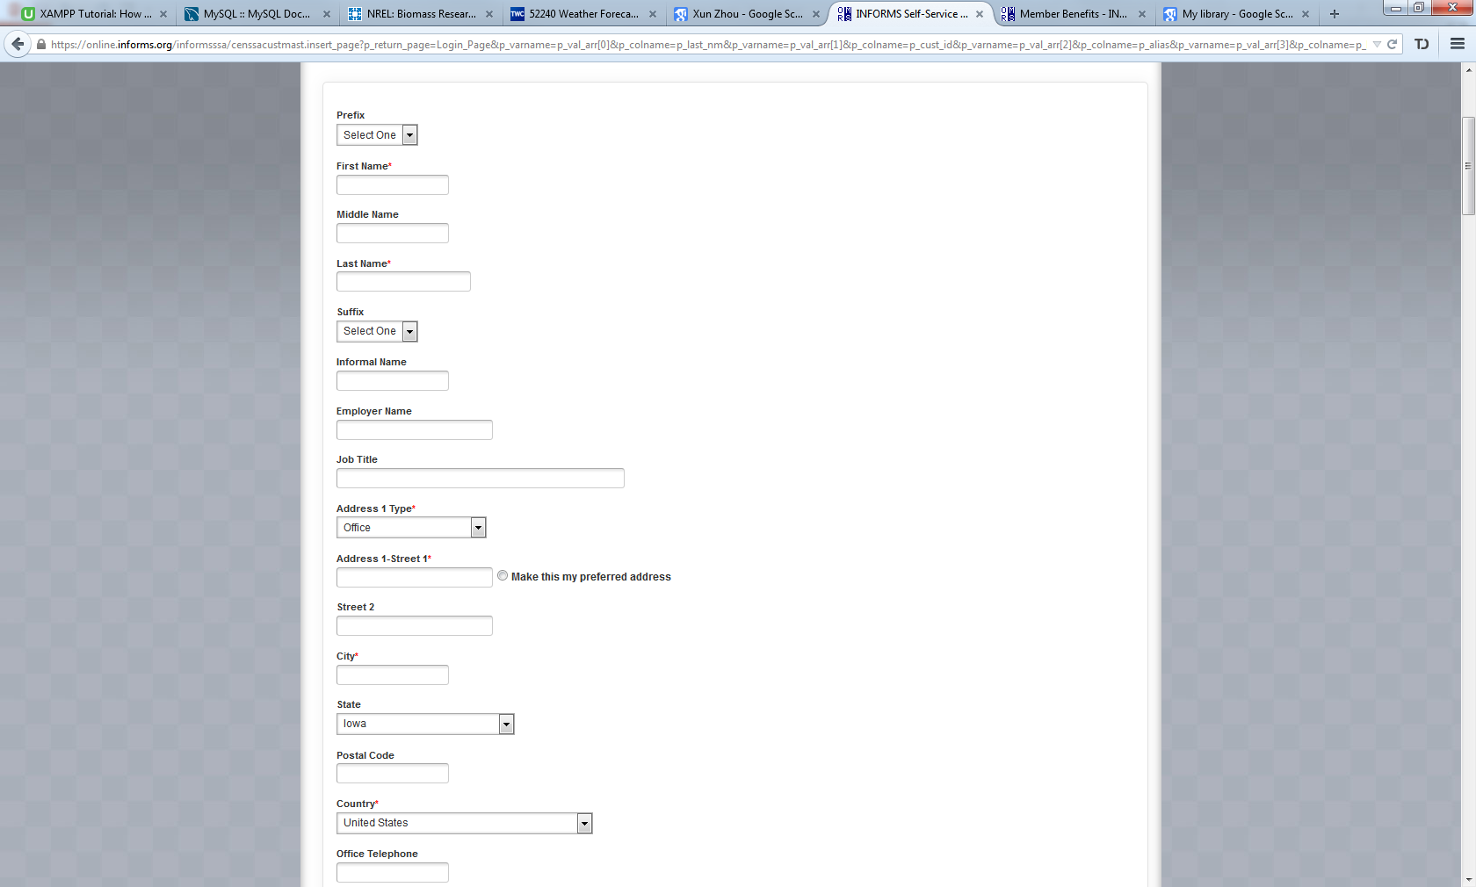

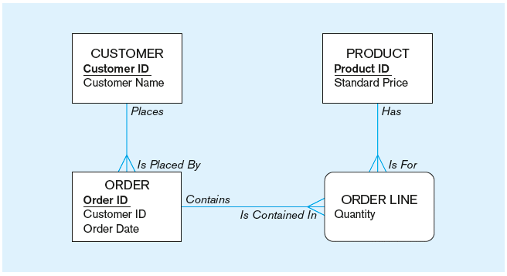
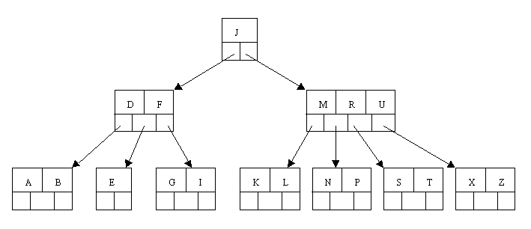
Three-Schema Architecture of database
Focus of DB users, analysts and application developers
External Schema
App 1
App 2
App 3
SQL Query
Data Model/Relational Tables
Conceptual/Logical
Schema
Internal schema
Managed by DBMS
Focus of DBA and DBMS developers
Data access operations
Hard Disk
Physical Schema
Index and file organization on disk

Slide 38
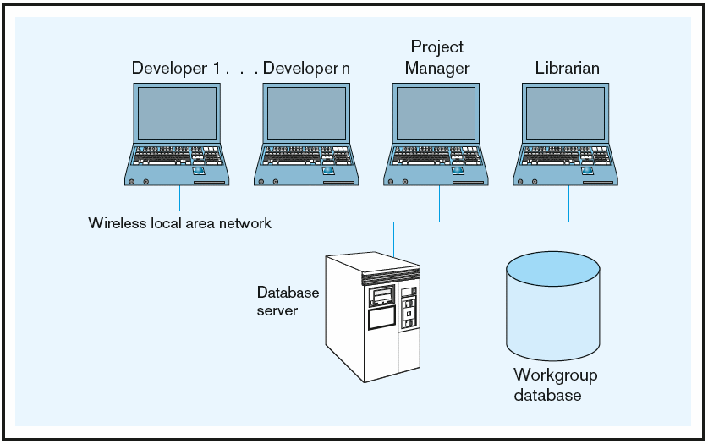
Range of Database Applications
Personal Database
On personal computers
Single user, not easy to share data
Examples: Microsoft ACCESS
Two-tier Client/Server Database
Data sharing in workgroup
Each client runs user interface and business logic
Sever runs DBMS and the database
Data security and data integrity issues
Most DBMS support C/S model: Oracle, MySQL, …
clients
Server
Two-tier architecture

Slide 39
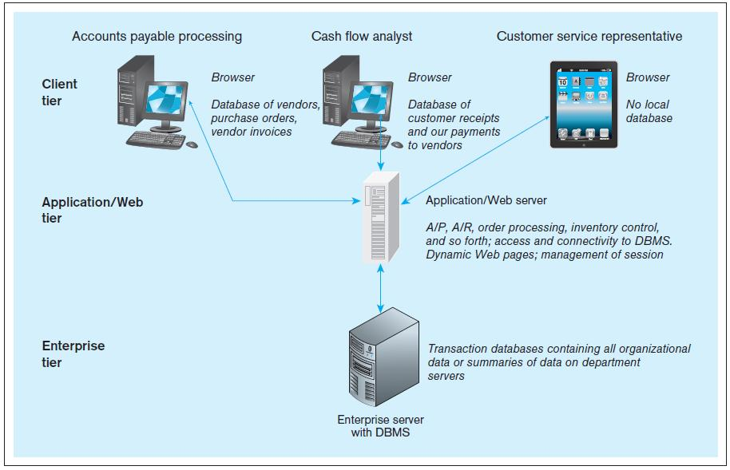
Range of Database Applications
Multi-tier Client/Server Database
Large number of users in a department/division
Client runs user interface only
Application/Web server contains business logic
Enterprise server runs DBMS and databases
Example: web app., cloud computing…
clients
App/Web Server
Enterprise Server

Slide 40
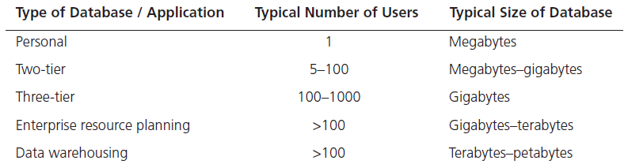
Enterprise Applications
Enterprise Resource Planning (ERP)
Integrate operational data from all functions of the enterprise
manufacturing, finance, sales, marketing, inventory, accounting, human resources, supply chains
Focus on current operational data
Data Warehouse
Collect data from various operational databases
Provide users with historical data to find patterns and trends in support of decision making

Slide 41



New Applications and Models
Mobile Database
Connecting Server from mobile devices
Light-load DBMS on mobile devices
Spatial database/GIS
PostGIS, Oracle Spatial
Query Restaurants on Google Map or Yelp
No SQL Database: Text Management
Cloud computing
Amazon web service (AWS)
Microsoft Azure
Distributed Database
Hadoop

Slide 42
Introduction to Databases
Concepts: Data, Information, Metadata
Traditional File Processing Systems
Database Systems
Development Process

Slide 43
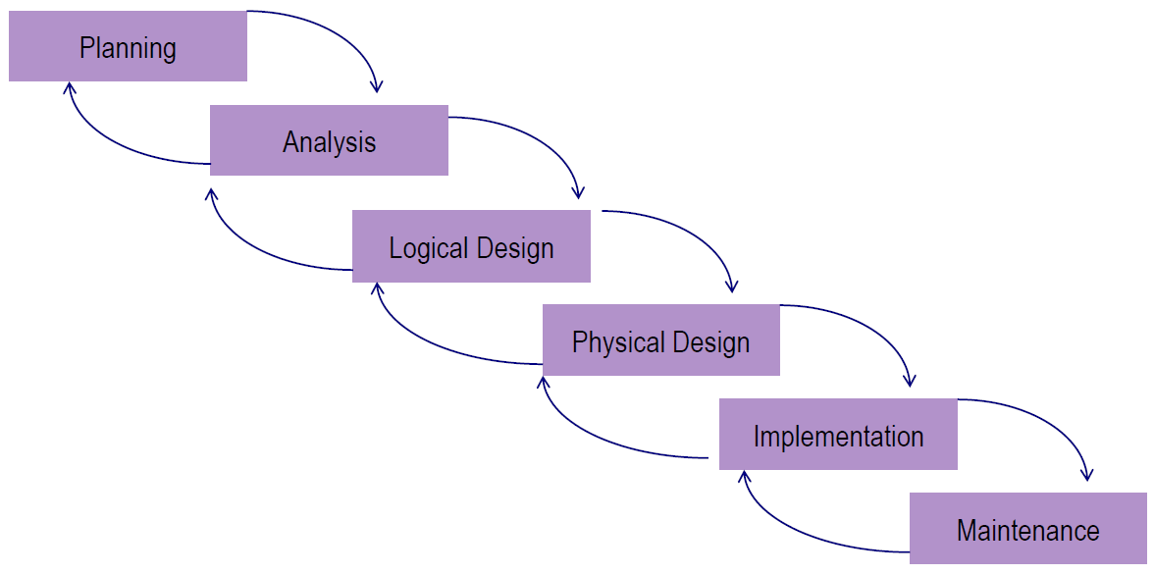
Systems Development Life Cycle (SDLC)
Develop a preliminary understanding
Analyze the business situation thoroughly
Generate a logical representation of data
Develop physical organization of data
Perform database implementation
Monitor/repair and enhance the system

Slide 44

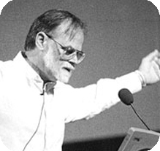



History and Academic Research
A major area in Computer Science Research
ACM Turing Awardees related to database research
Edgar F. Codd (1981)
Jim Gray (1998)
Michael Stonebraker (2014)
Jeffrey Ullman & Alfred Aho (2020)
Major research areas:
Query processing, indexing, storage management, computing theories, applications
Expanded areas: data mining, parallel computing, cloud computing
AI for DB and DB for AI

Slide 45
Summary
Concepts: Data, Information, Metadata
Traditional File Processing Systems
Database Systems
Development Process

